Slide 1
Partner name- project
Provide a brief summary of the partnership
Include highlights such as:
- Partnership type
- Other partners involved
- Volunteer hours/donated materials in the FY
- Management objectives accomplished
- Any outreach/public awareness
Please include 1 or 2 photos of partnership in action

Slide 2
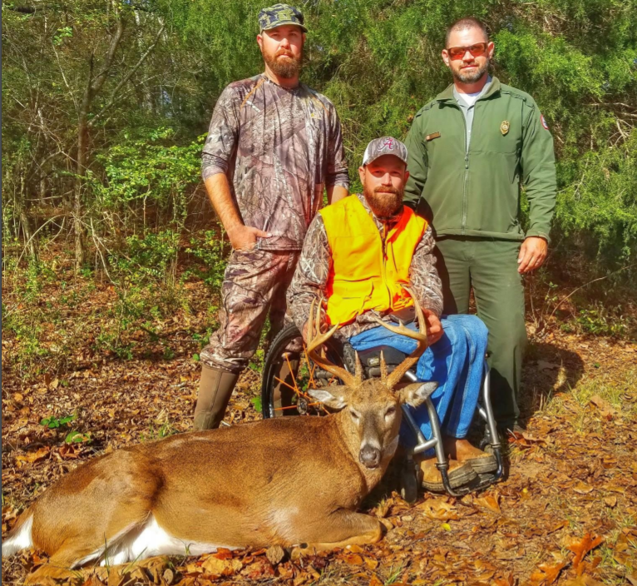
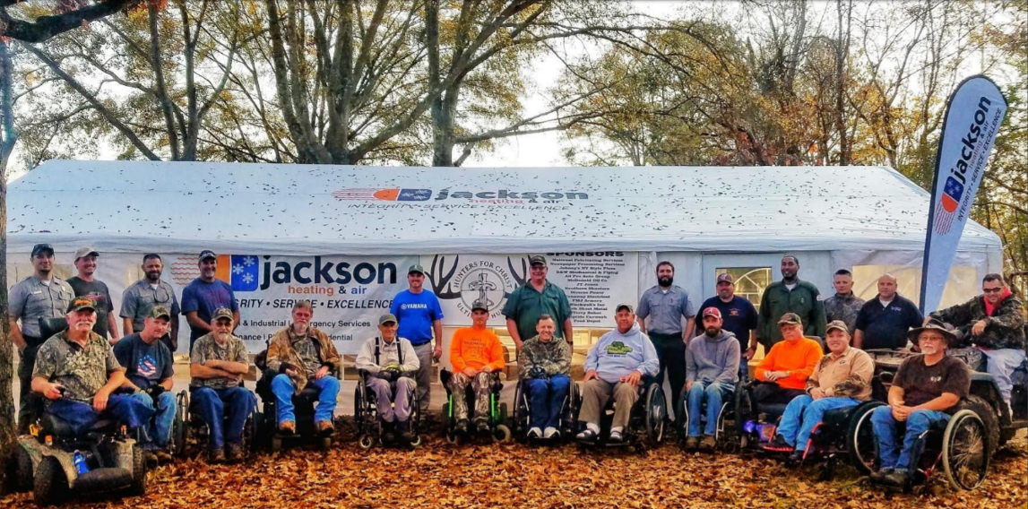
Example: Hunters for Christ- West point lake
Hunters for Christ supports the West Point Project’s hunts for physically disabled hunters. This partnership assists with the overpopulation of deer in West Point campgrounds, while providing an enriched hunting opportunity for permanently physically disabled hunters.
Partnership established in 2004
Partner has secured additional sponsors who provide climate controlled tent, meals, door prizes, and taxidermy services.
Over 1800 volunteer hours provided between 2017-2018.
Partnership type: Contributions Program

